Slide 1
Virtual Machine and Linux Installation

Slide 2
Table of Contents
Virtual Machine Installation
Linux Installation
Linux Quick Overview
Linux Installation Continue
Other Virtual Machine Installation (VM1, VM2, VM3)

Slide 3
Environment
VirtualBox 6.0.18
- https://www.virtualbox.org/wiki/Download_Old_Builds_6_0
Linux image – ubuntu 18.04.4 (64 bits) - http://old-releases.ubuntu.com/releases/18.04.4/
=> ubuntu-18.04.4-desktop-amd64.iso
For assignment, prepare disk space about 3~40GB

Slide 4
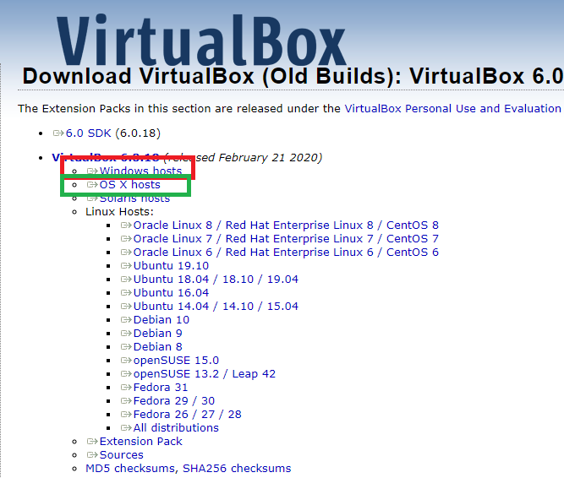
VirtualBox download page
Red Box – Windows
Green Box - Mac

Slide 5
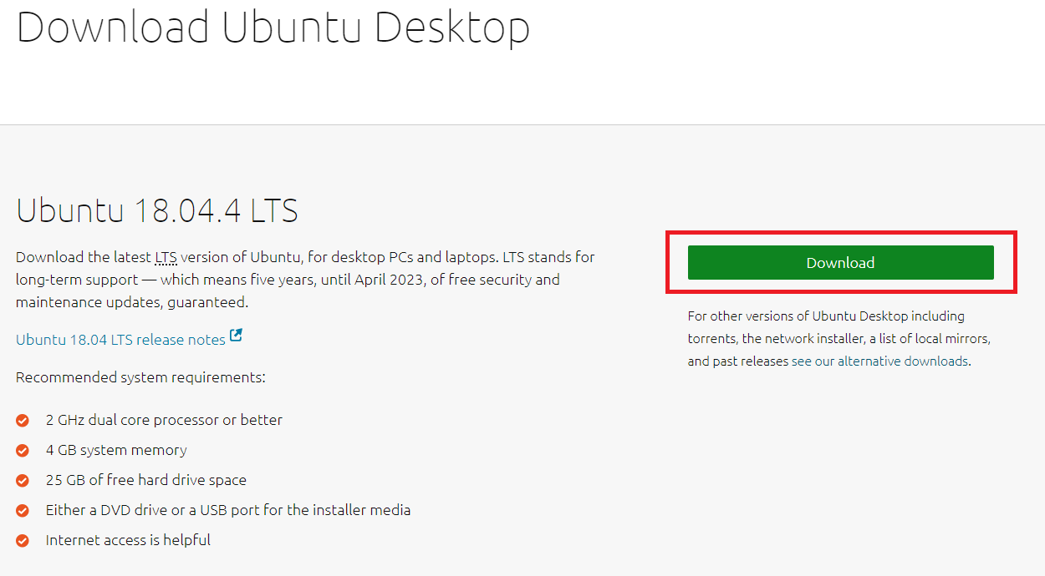
Click download (You don’t need to click after page changes)

Slide 6
Virtual Machine Installation
Launch Installation File
Click Next, Install, and Yes only
* Warning
All installation path name must be English
Ex) C:/Users/컴네/…… (X), C:/Users/ComNe/…. (O)

Slide 7
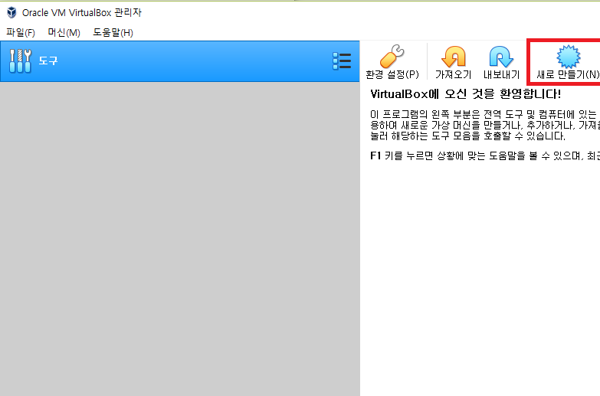
Creating Virtual Machine

Slide 8
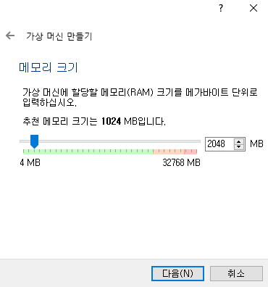
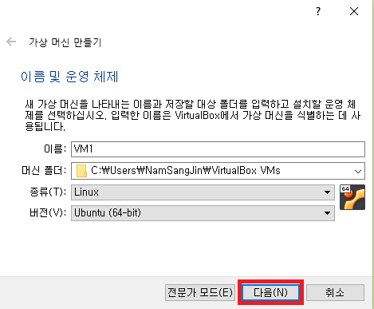
Creating Virtual Machine

Slide 9
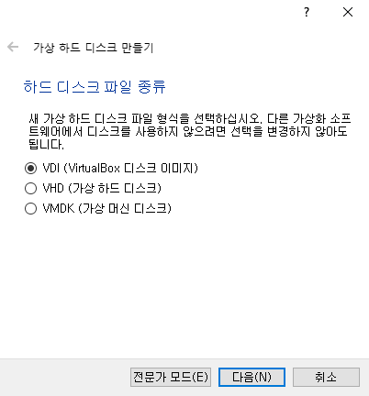
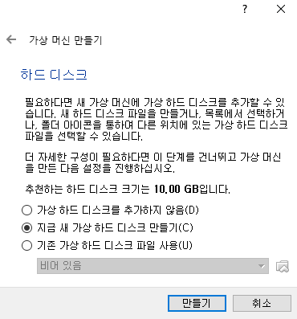
Creating Virtual Machine
Just click next and create

Slide 10
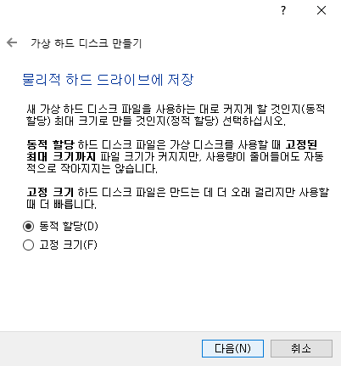
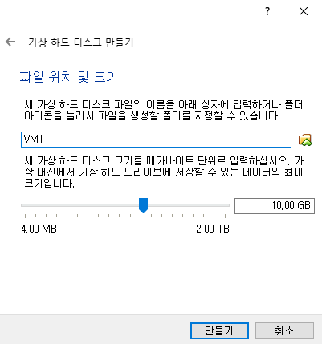
Creating Virtual Machine
Just click next and create

Slide 11
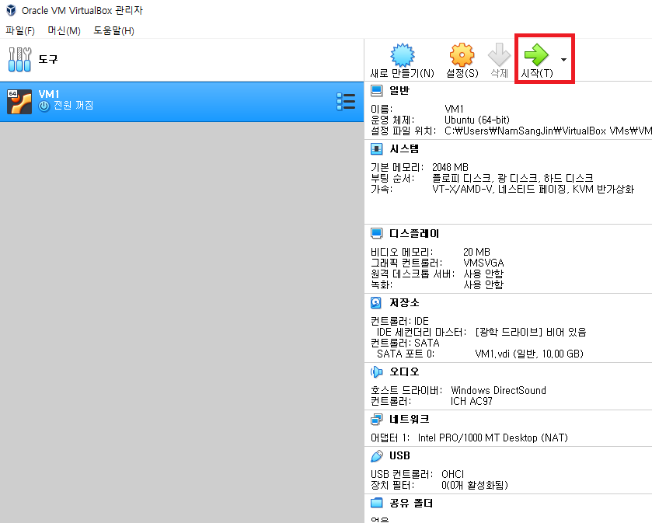
Linux Installation

Slide 12
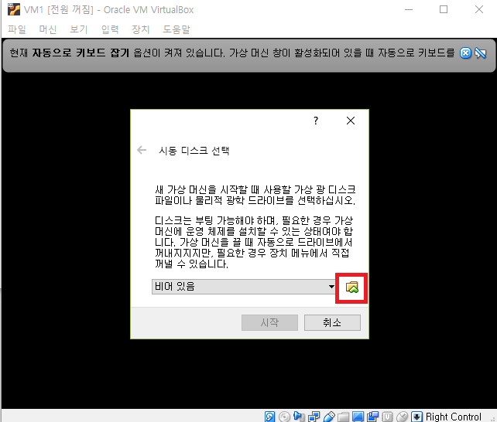
Linux Installation

Slide 13
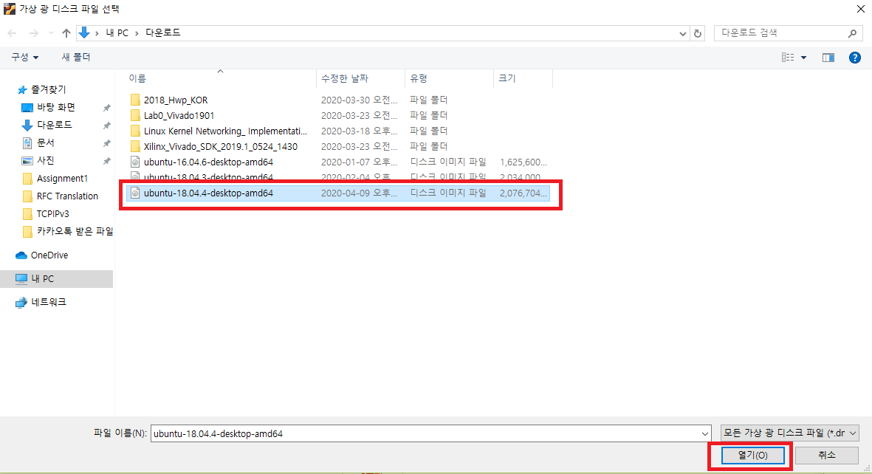
Linux Installation

Slide 14
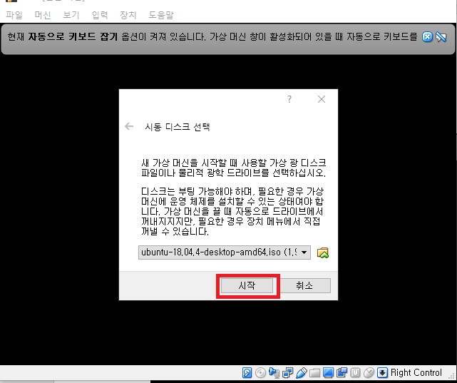
Linux Installation

Slide 15
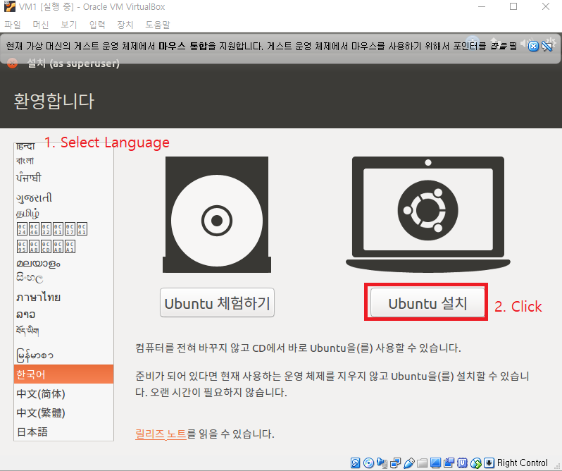
Linux Installation

Slide 16
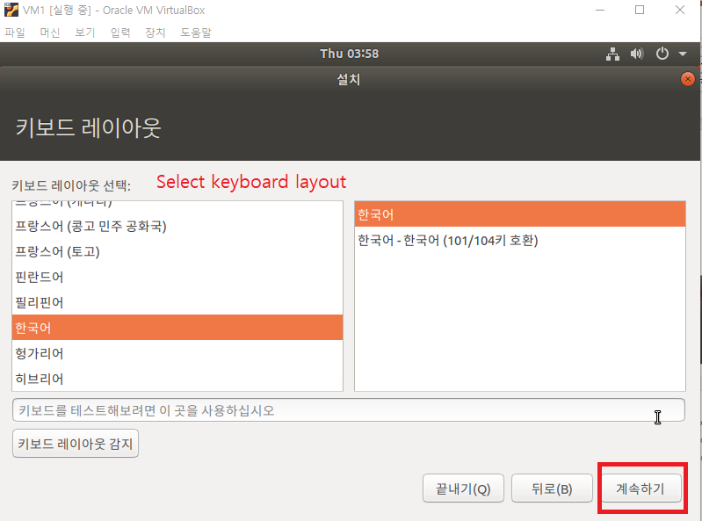
Linux Installation

Slide 17
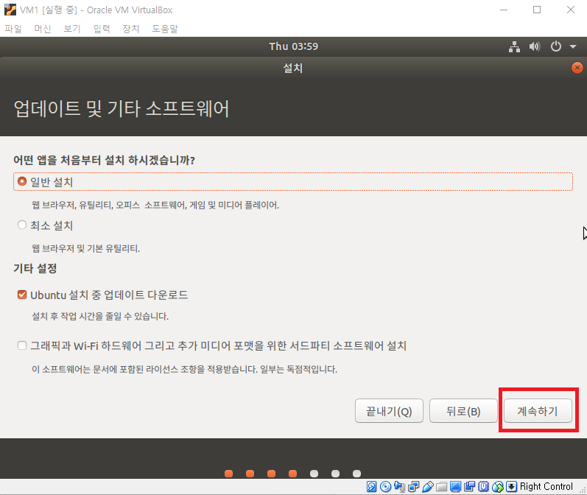
Linux Installation

Slide 18
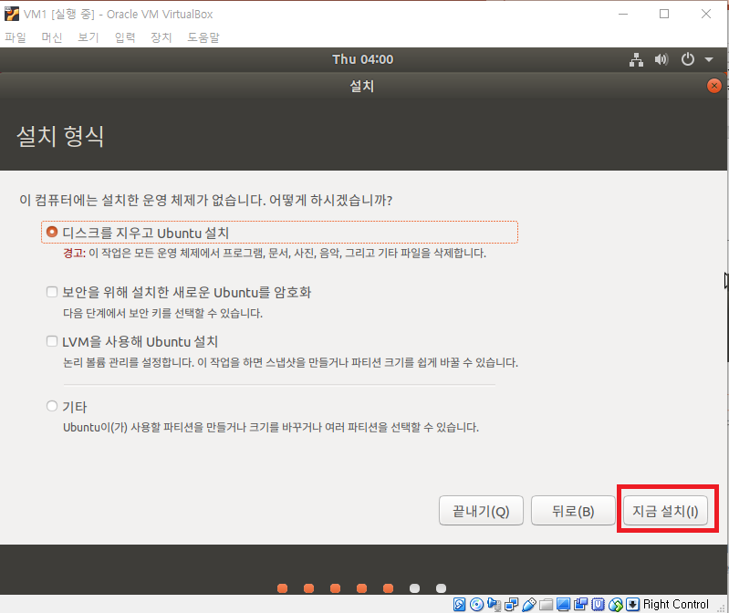
Linux Installation

Slide 19
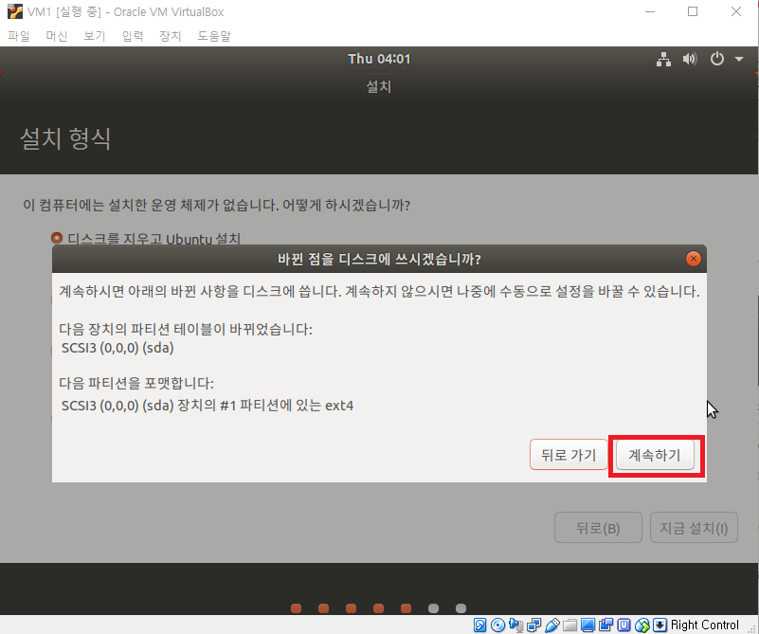
Linux Installation

Slide 20
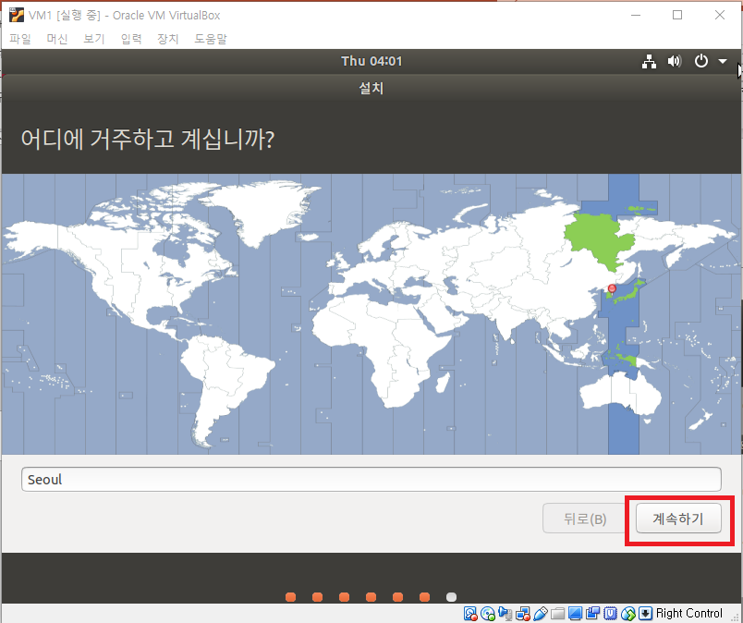
Linux Installation
Set timezone

Slide 21
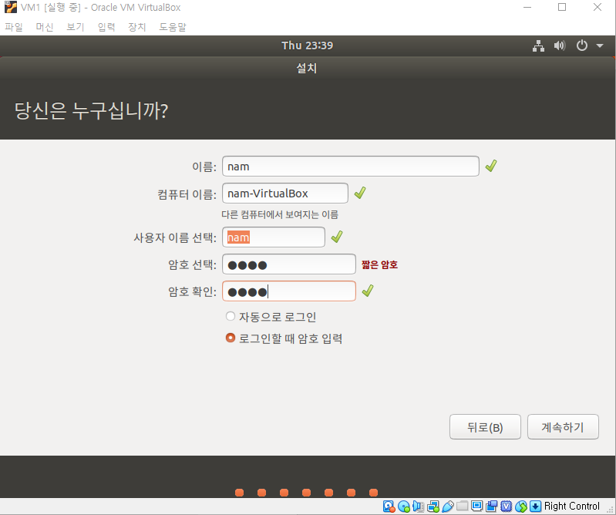
Linux Installation

Slide 22
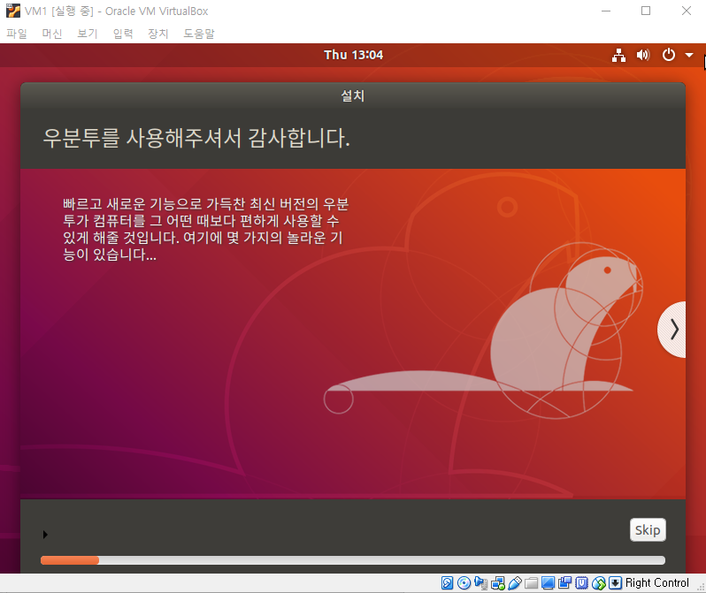
Linux Installation
Wait..
Installation End =>
Click Restart and
Press Enter after a while

Slide 23
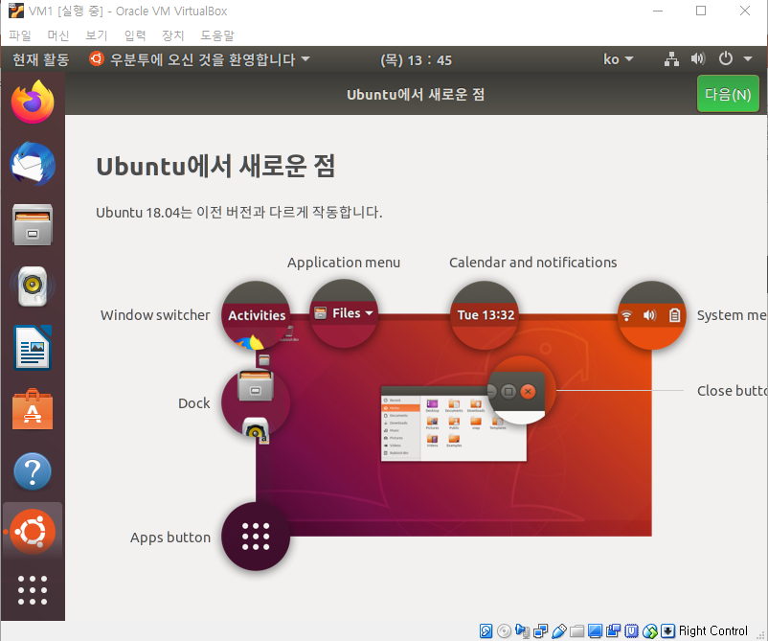
Linux Quick Overview
Click to
open terminal
System power
1. Firefox
2. Directory

Slide 24
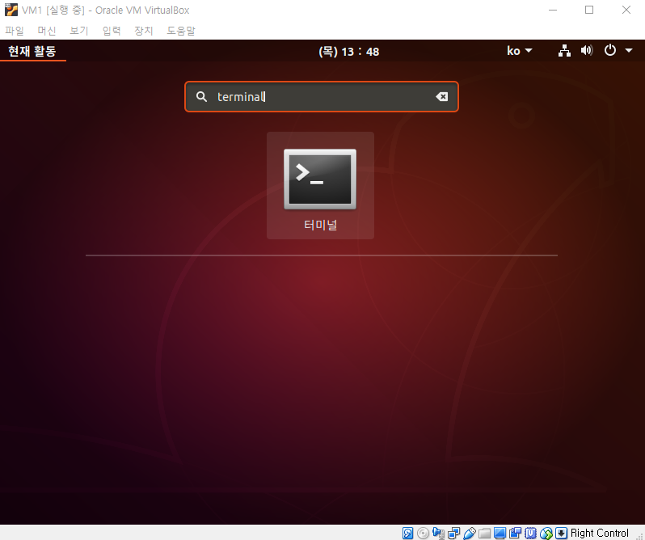
Linux Quick Overview

Slide 25
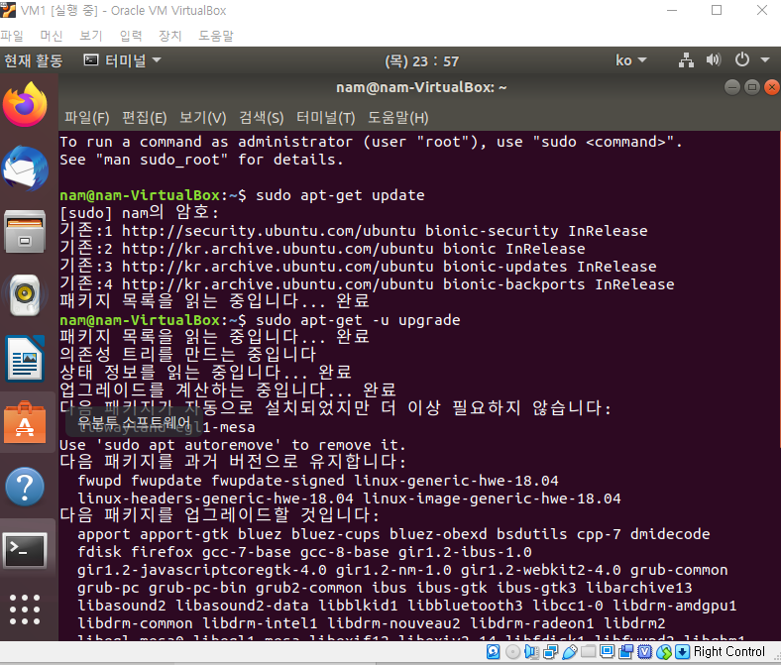
Linux Installation Continue
sudo apt-get update
sudo apt-get –u upgrade
Enter and
input your password
(not printed)
* sudo : command for root permission

Slide 26
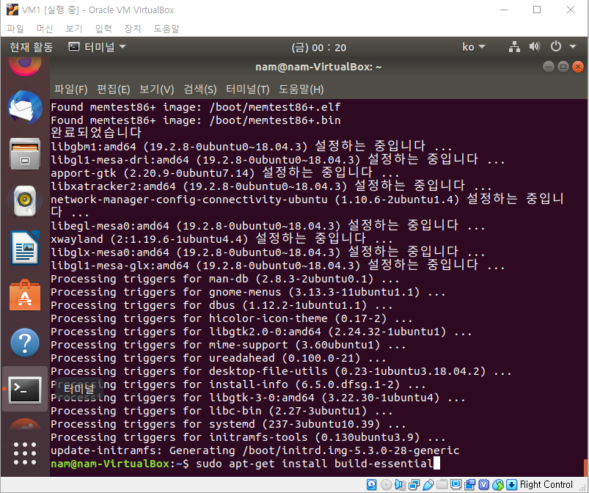
Linux Installation Continue

Slide 27
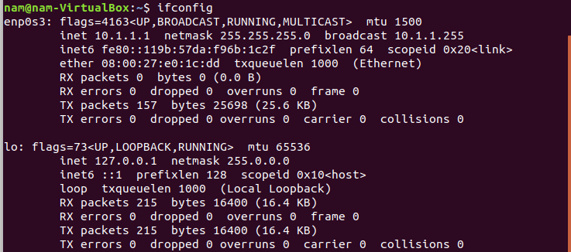
Linux Installation Continue
Type ifconfig and it operates => OK

Slide 28
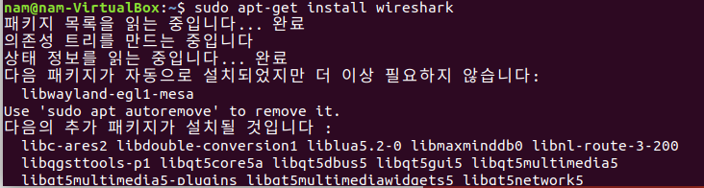
Wireshark Installation
.
.
.

Slide 29
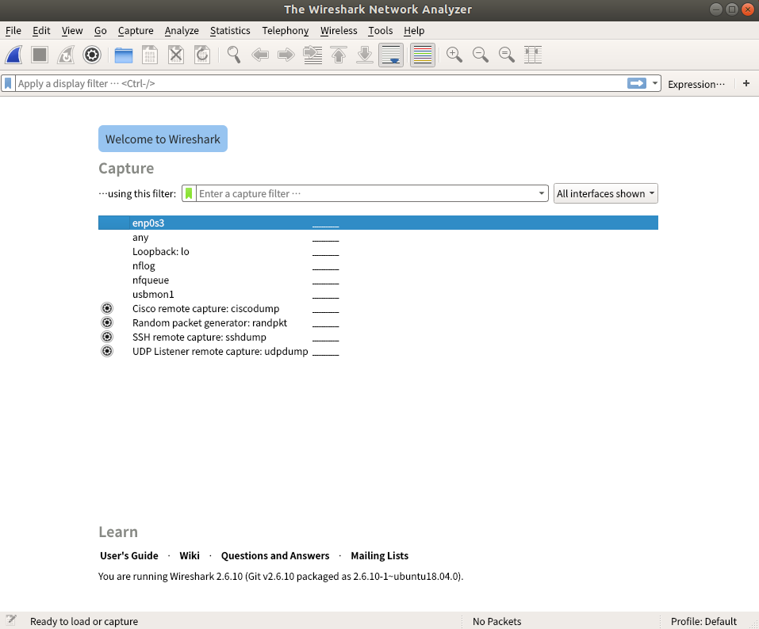
Wireshark Installation

Slide 30
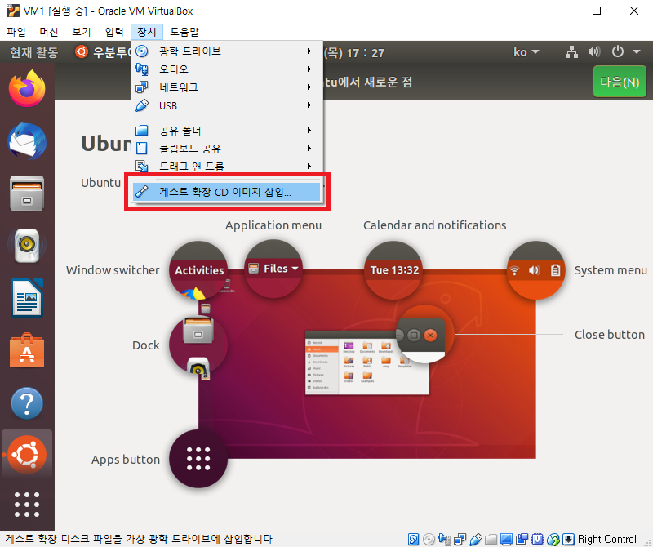
Linux Installation Continue
Finally, sudo reboot

Slide 31
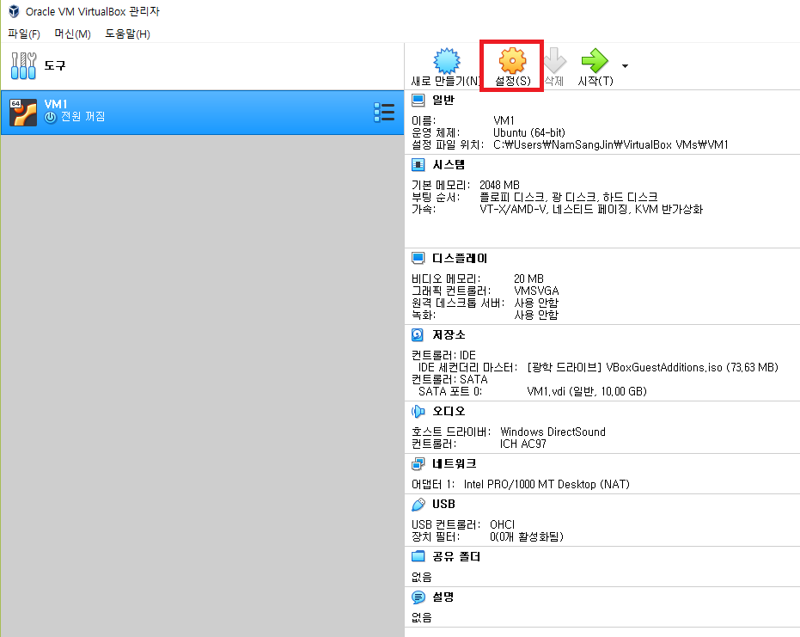
Sharing Folder
Check whether VM is off.

Slide 32
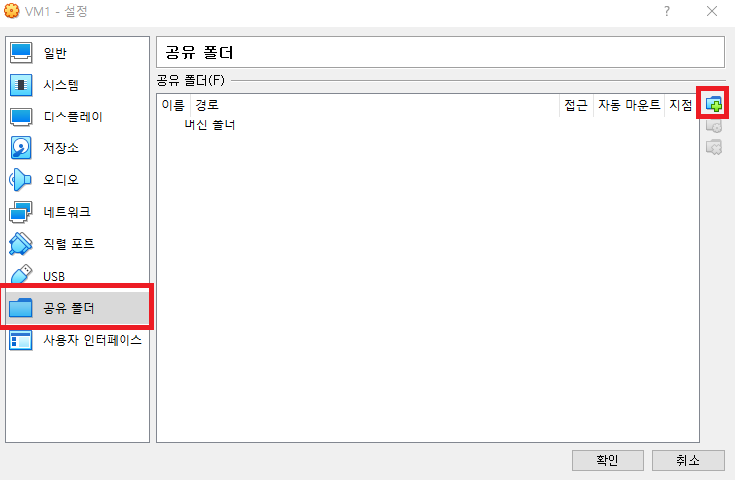
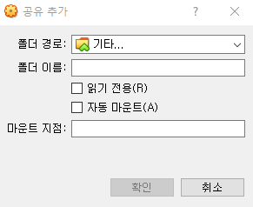
Sharing Folder

Slide 33
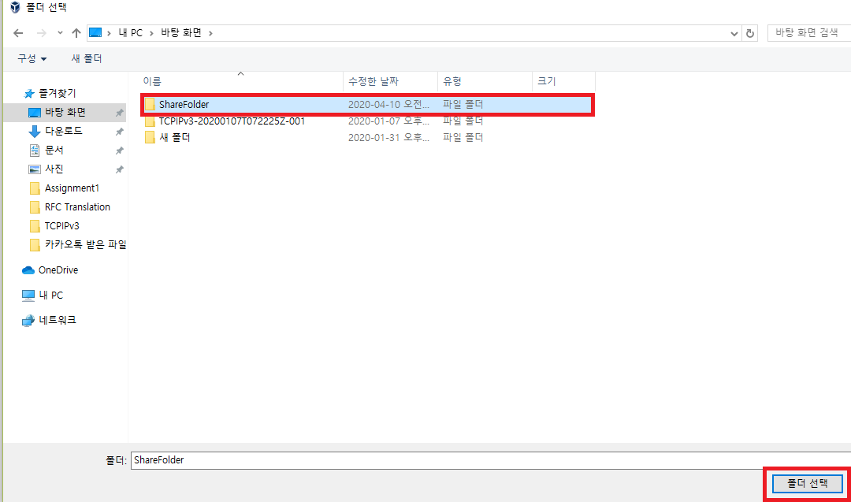
Sharing Folder

Slide 34
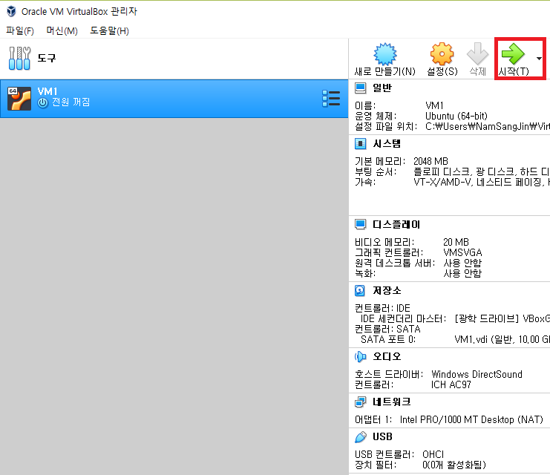
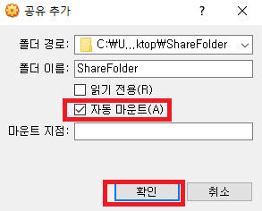
Sharing Folder
Click OK, OK

Slide 35
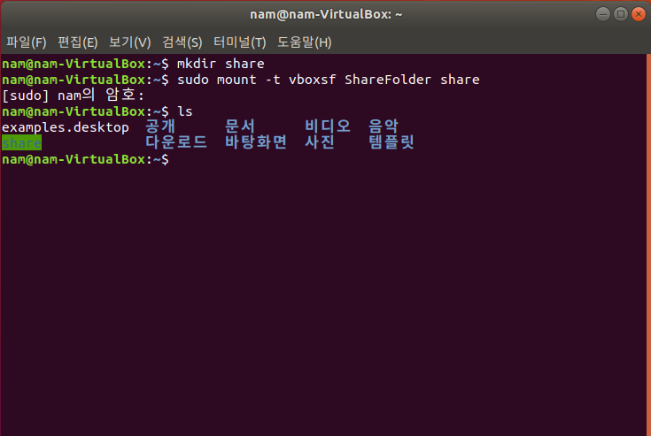
Sharing Folder
Turn on terminal, and
**
Red – folder name
on host os (windows)
Green – folder name
on linux
**

Slide 36
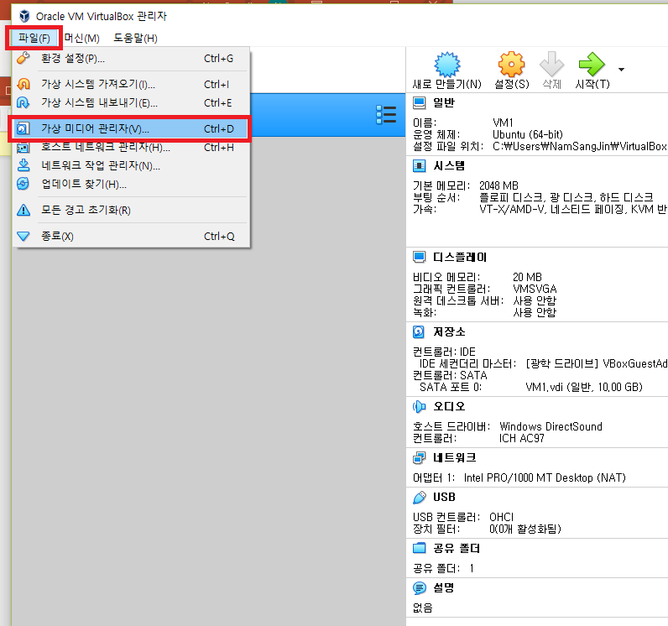
Other Virtual Machines Installation

Slide 37
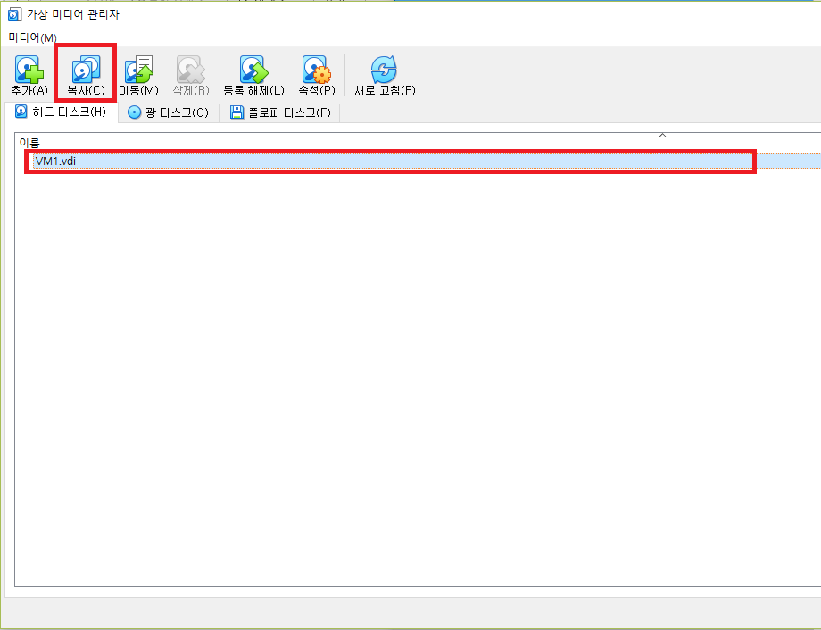
Other Virtual Machines Installation

Slide 38
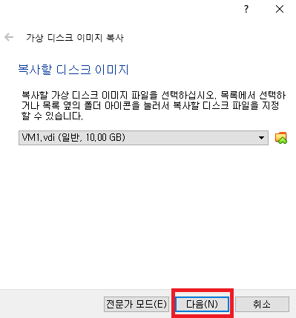
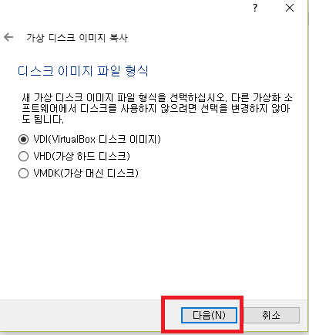
Other Virtual Machines Installation

Slide 39
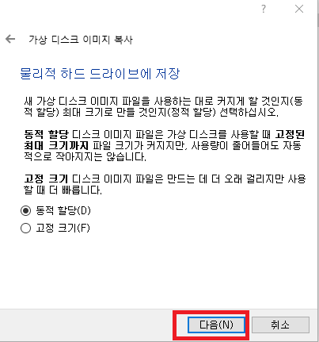
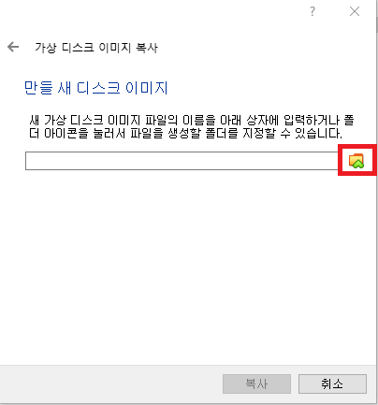
Other Virtual Machines Installation

Slide 40
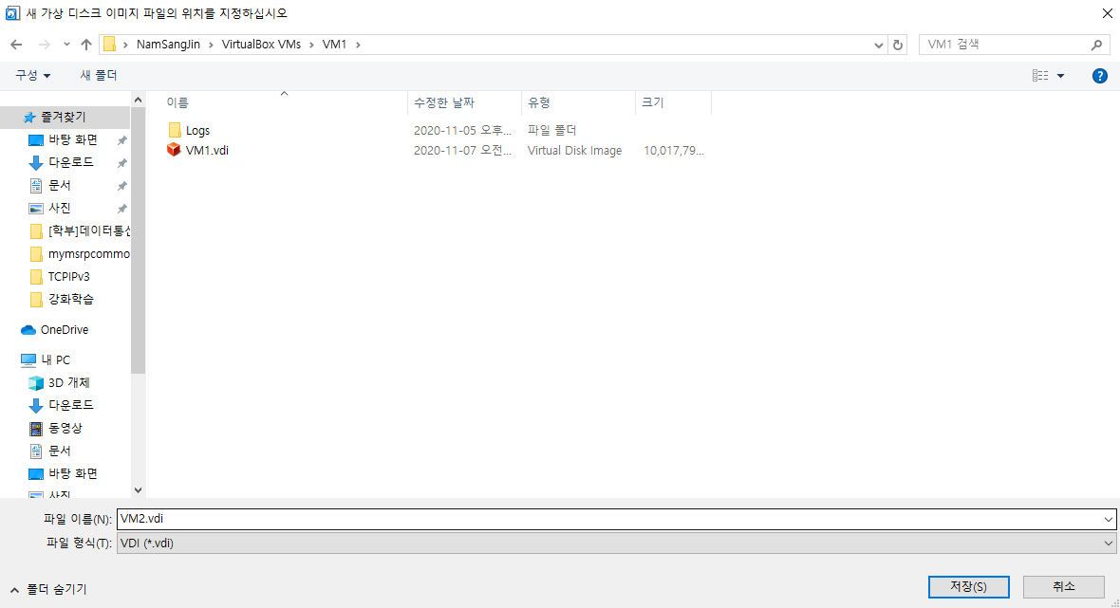
Other Virtual Machines Installation

Slide 41
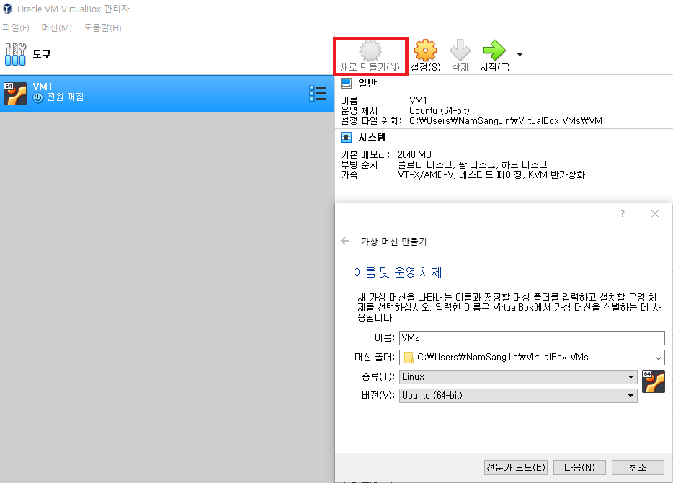
Other Virtual Machines Installation

Slide 42
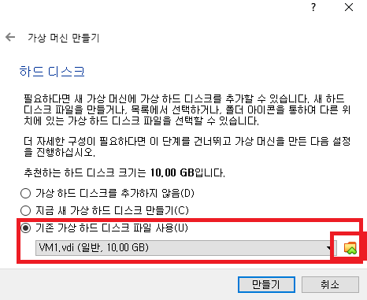
Other Virtual Machines Installation

Slide 43
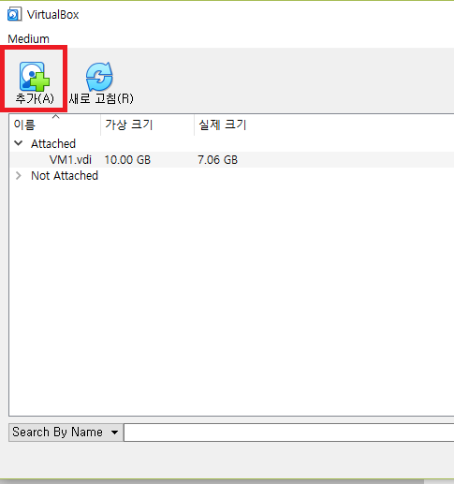
Other Virtual Machines Installation

Slide 44
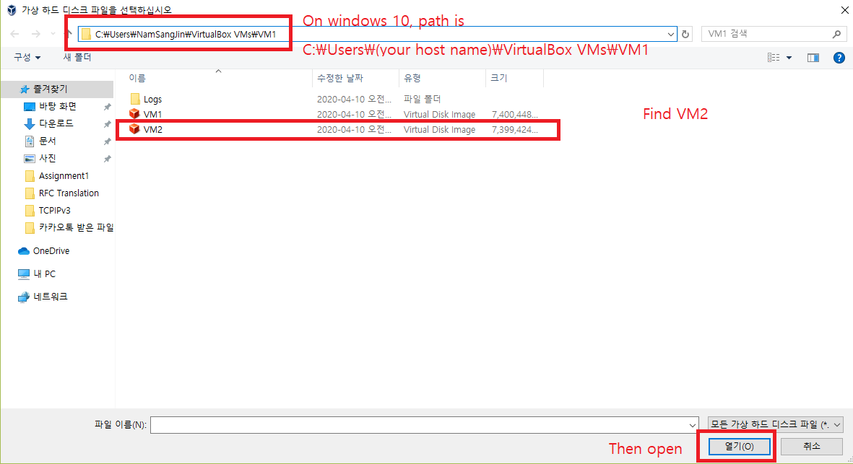
Other Virtual Machines Installation

Slide 45
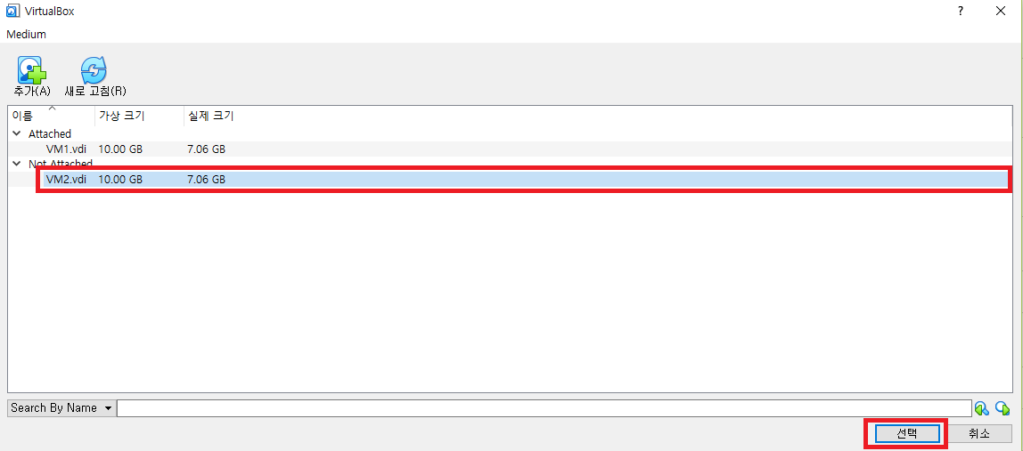
Other Virtual Machines Installation

Slide 46
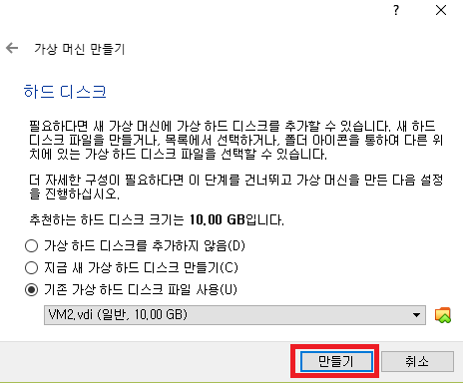
Other Virtual Machines Installation

Slide 47
Other Virtual Machines Installation
Start VM2 and insert guest image (ppt 30)
Configure ShareFolder using same way (ppt 31 ~) (except mkdir share)
Make VM3 also.

